Slide 1



Digital Twins, Blockchain & Brokers: A Triad for Bulawayo's Green Economy
BEDCON 2025 | Mduduzi P. Ndebele, NVN
Framework proven in Singapore, Amsterdam, and Kenya – now tailored for Africa.
by mduduzi mazankosi
Notes:
Bulawayo, the city we're focusing on, has a distinct skyline that serves as the backdrop for this transformative initiative We'll explore how Digital Twins, Blockchain, and Brokers can work together to drive Bulawayo's transition to a green economy This framework has proven successful in other cities like Singapore, Amsterdam, and Kenya - now we're tailoring it for the African context Digital Twins allow us to monitor and optimize urban systems in unprecedented ways Blockchain introduces secure, transparent transactions to support green economic activities Brokers play a crucial role in facilitating these interactions and ensuring effective communication among diverse stakeholders Integrating these three pillars will enhance the efficacy and impact of Bulawayo's burgeoning green economy

Slide 2
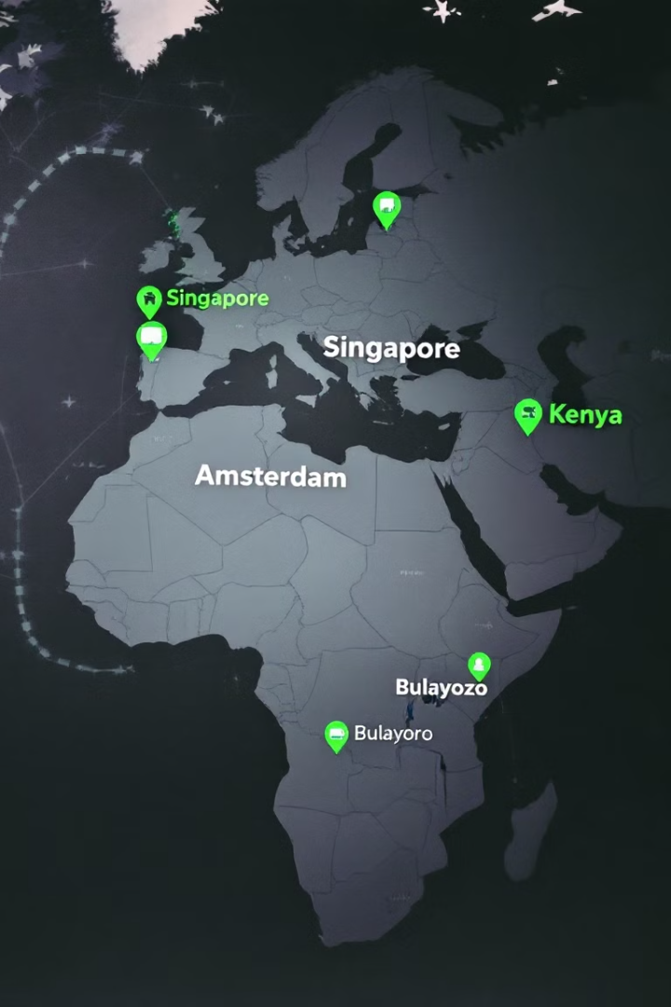




Global Success Stories
Singapore
Amsterdam
Kenya
Cut CO2 by 30% using digital twins
Recycled 60% plastics via blockchain
M-KOPA electrified 1M homes through blended finance
Bulawayo
Poised to connect local innovation to global capital
Notes:
The world map on this slide highlights four cities - Singapore, Amsterdam, Kenya, and Bulawayo - that have achieved impressive sustainability results through innovative technologies and financing models. In Singapore, digital twins were used to cut CO2 emissions by 30%. Amsterdam was able to recycle 60% of its plastics through blockchain technology. In Kenya, the M-KOPA program has electrified 1 million homes using blended finance. Bulawayo is poised to replicate these successes, but needs to develop systems to connect local innovation to global capital. These global success stories demonstrate the power of technology, finance, and cross-border collaboration to drive sustainable development.

Slide 3






Key Objectives
Digital Twins
Real-Time Tracking of Green Projects
Blockchain
Transparent $50M Green Growth Fund
Brokers
NVN as Neutral Broker (EU Green Deal, AfDB)
Notes:
• Our key objectives are to use digital twins to track green projects in real-time, secure a $50M green growth fund through blockchain, and position NVN as a neutral broker connecting startups to global market capital. • Digital twins will allow us to monitor projects like biogas plants, providing live dashboards on CO2 impact and ROI. • Blockchain will help prevent fraud and ensure transparency for the Bulawayo Green Fund. • As a trusted broker, NVN can link startups to funding opportunities like the EU Green Deal and AfDB programs, as well as technology partners like Siemens. • These three pillars - digital twins, blockchain, and brokerage - will be crucial to driving sustainable growth and impact.

Slide 4
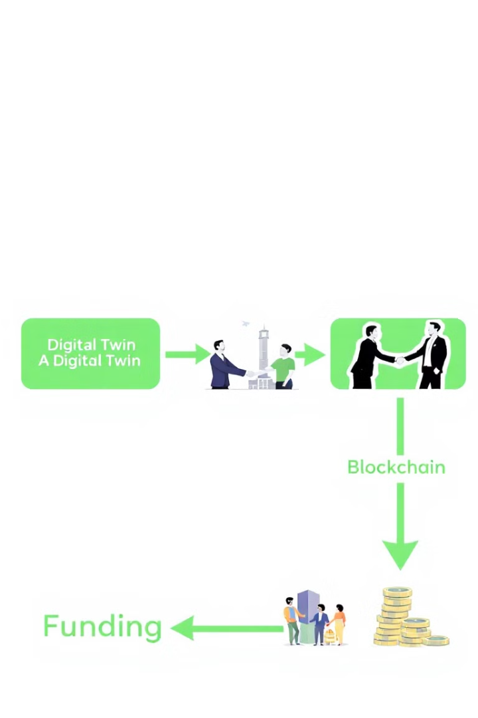




Implementation Process
Digital Twins
Model biogas plant with live CO2 and ROI dashboards
Blockchain Ledger
Record every dollar in $50M Green Fund
Brokers
NVN facilitates deals like Kenya's M-KOPA success
Funding
Secure investment for green projects
Notes:
Digital twins allow us to model and simulate biogas plants, like the one at Bulawayo's Ingozi Mine, providing investors with live data on CO2 emissions and return on investment We'll use blockchain technology to transparently record every dollar flowing through our $50M Green Fund, similar to the approach taken by Dalberg in Amsterdam Our team at NVN will leverage proven models like the World Bank's 4Ps and MIGA insurance to broker deals, replicating the success we saw with M-KOPA in Kenya This end-to-end process, from digital twins to blockchain to brokered funding, is designed to give investors the visibility and confidence they need to support green projects in emerging markets

Slide 5
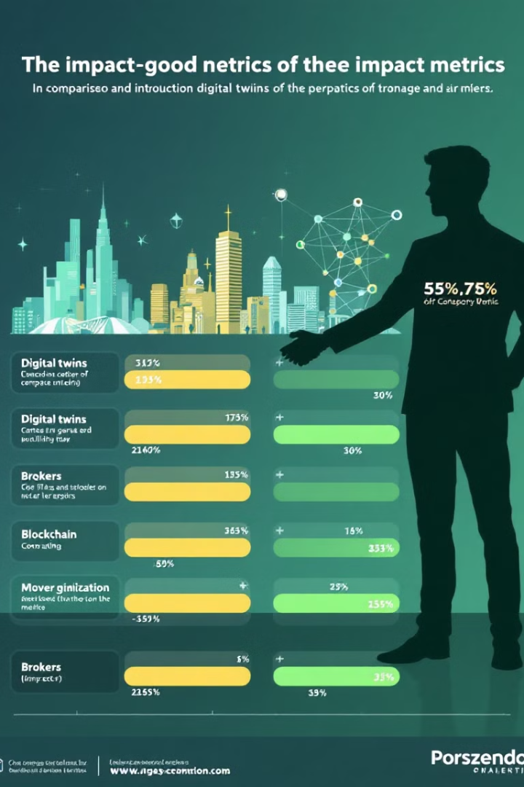
Impact Metrics
Solution
Case Study
Impact
Digital Twins
Singapore
30% faster due diligence
Blockchain
Amsterdam
40% fraud reduction
Brokers
Kenya
$200M mobilized for solar
Triad Framework
Bulawayo (target)
$365M in green finance
Notes:
• The slide presents a comparison of impact metrics for different solutions across various case studies. • For digital twins, the case study in Singapore showed a 30% reduction in due diligence time. • For blockchain, the case study in Amsterdam demonstrated a 40% reduction in fraud. • In Kenya, brokers were able to mobilize $200M for solar projects. • The Triad Framework, which is the focus of this presentation, aims to replicate these successes in Bulawayo, targeting $365M in green finance and 15,000 jobs by 2030. • These impressive results showcase the potential impact of innovative solutions like digital twins, blockchain, and brokers in driving sustainable development.

Slide 6
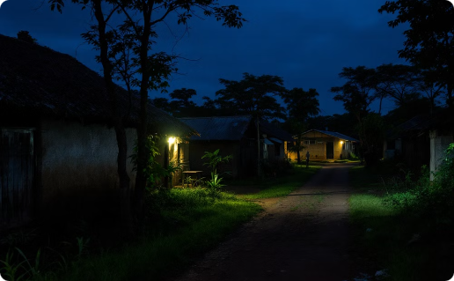

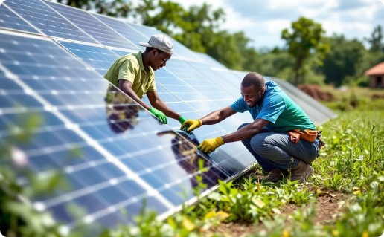
Kenya's M-KOPA Success Story
Before
After
Implementation
Unelectrified homes, limited economic activity
1M homes electrified, 5,000 jobs created
Combined EU grants with private equity and World Bank tools
Notes:
Kenya's M-KOPA is a remarkable success story in off-grid electrification Before, many Kenyan homes were unelectrified, limiting economic activity After M-KOPA's efforts, over 1 million homes were electrified and 5,000 jobs were created This was achieved by blending EU grants with private equity, and leveraging World Bank risk-mitigation tools This model of combining public and private financing can be replicated for Bulawayo's solar farms and smart water kiosks

Slide 7






Success Factors
Trust
MIGA insurance mitigates risks
Technology
Digital twins and blockchain provide transparency
Partnerships
NVN leverages neutrality as broker
Notes:
Technology like digital twins and blockchain can provide transparency and traceability across the supply chain MIGA insurance helps mitigate political and other risks, building trust among stakeholders Neutral brokers like NVN can leverage their neutrality to bring partners together and align incentives Examples from Singapore, Amsterdam, and Bulawayo show how these tools and partnerships can help scale initiatives The key is adopting these technologies, working with global brokers, and building the necessary trust and alignment among stakeholders

Slide 8
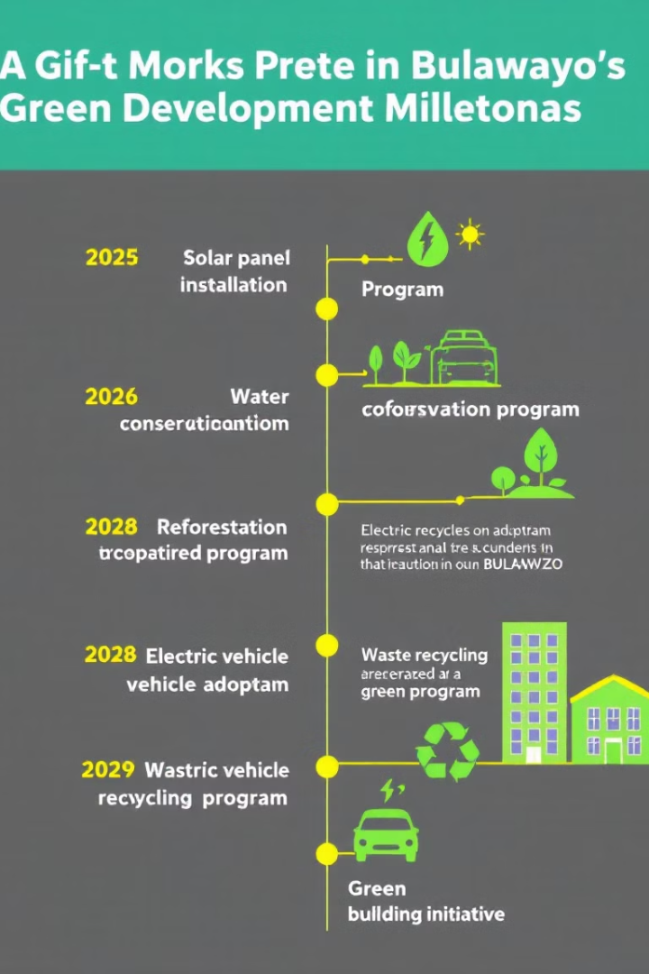




Bulawayo's Green Roadmap
2025
Launch Digital Twin pilot projects
2026
Secure $50M Green Fund
2028
Scale biogas and solar initiatives
2030
15,000 green jobs created
Notes:
Bulawayo is on a journey to become Africa's green innovation hub By 2026, we aim to secure a $50M Green Fund using blockchain technology This will help scale our biogas and solar initiatives by 2028 Our goal is to create 15,000 green jobs by 2030 and cut 150K tons of CO2 annually We're looking to partner with organizations that can help us replicate the transparency of Singapore, the scale of Kenya, and the circularity of Amsterdam The tools are ready, now let's act and turn Bulawayo into a leading green city

Slide 9

Resources & Contact
World Bank Resources
World Bank 4Ps Toolkit (Public-Private-People Partnerships) Link: https://ppi.worldbank.org Relevance: Framework for de-risking green investments in emerging markets.
World Bank, Blended Finance for Climate Action Link: https://openknowledge.worldbank.org/handle/10986/39804 Relevance: Validates Kenya's M-KOPA solar model and NVN's proposed $50M Green Growth Fund.
World Bank's PPI Database Link: https://ppi.worldbank.org Relevance: Tracks 7,000+ infrastructure partnerships, informing NVN's strategy.
Global Case Studies & Brokers
Kenya's M-KOPA Solar (Gearbox Africa as Broker) Source: M-KOPA Secures $200M to Expand Solar Access Link: https://m-kopa.com/press Relevance: Demonstrates blended finance success in electrifying 1M homes.
Amsterdam's Circular Economy Twin (Dalberg as Advisor) Source: Amsterdam Circular Economy Strategy Link: https://www.amsterdam.nl/en/policy/sustainability/circular-economy Relevance: Blockchain-enabled waste tracking reduced landfill use by 40%.
Singapore's Virtual Twin Initiative (Roland Berger as Innovation Ambassador) Source: Singapore's Building and Construction Authority (BCA) Link: https://www.bca.gov.sg/GreenMark/others/3D_SSB_Virtual_Twin.pdf Relevance: Digital twins unlocked $200M in green bonds for retrofitting.
Rwanda-OneWeb Satellite Partnership (Rwanda Utilities Regulatory Authority as Diplomat) Source: OneWeb Press Release Link: https://oneweb.net/media-center Relevance: Brokered $200M for rural connectivity using MIGA guarantees.
Theoretical Frameworks:
1
Innovation Diplomacy (Hutt & Walker, 2022)
2
Circular Economy Theory (Ellen MacArthur Foundation)
NVN's role as a neutral broker aligns with cross-sector trust-building.
Validated by Amsterdam's 60% plastic recycling success.
Compliance: Aligns with SDGs 9 (Industry), 11 (Cities), and 13 (Climate Action).
Author Information
References:
World Bank. (2023). Blended Finance for Climate Action. https://openknowledge.worldbank.org/handle/10986/39804
Gearbox Africa & M-KOPA. (2024). $200M Solar Expansion Press Release. https://m-kopa.com/press
City of Amsterdam. (2023). Circular Economy Strategy. https://www.amsterdam.nl/en/policy/sustainability/circular-economy
Roland Berger & BCA Singapore. (2022). Virtual Twin Initiative Report. https://www.bca.gov.sg/GreenMark/others/3D_SSB_Virtual_Twin.pdf
MIGA. (2024). Political Risk Insurance. https://www.miga.org
EU Commission. (2024). Green Deal Funding Mechanisms. https://ec.europa.eu
Hutt, R., & Walker, J. (2022). Innovation Diplomacy in Emerging Markets. Technological Forecasting & Social Change. https://doi.org/10.1016/j.techfore.2022.121876
Notes:
• The World Bank has several key resources that are highly relevant to our green initiatives in Bulawayo, including the 4Ps Toolkit, the Blended Finance for Climate Action report, and the PPI database. • We've also identified successful global case studies and brokers that can inform our work, like M-KOPA Solar in Kenya, Amsterdam's circular economy efforts, Singapore's virtual twin initiative, and the Rwanda-OneWeb satellite partnership. • Theoretically, our role as a neutral broker aligns with the concept of "innovation diplomacy", and the circular economy principles validated in places like Amsterdam. • Importantly, our work supports the UN's Sustainable Development Goals 9, 11, and 13 around industry, cities, and climate action. • I encourage you all to reach out to NVN to explore partnership opportunities as we build Bulawayo's green future through innovative solutions like digital twins and blockchain. • These are the key resources and contacts that can help drive our sustainability agenda forward. I'm happy to discuss any of these in more detail.

